Slide 1
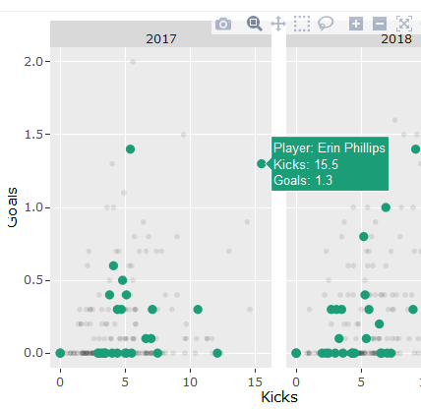
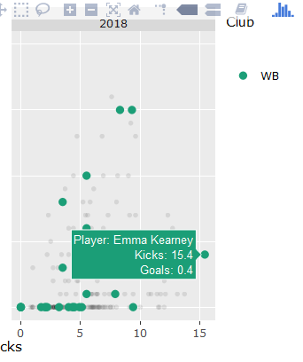
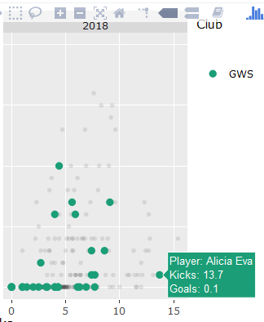
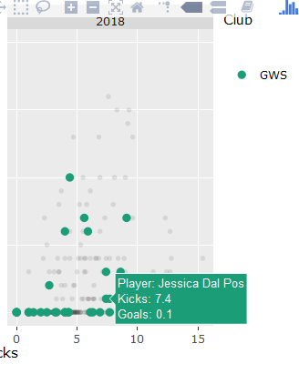
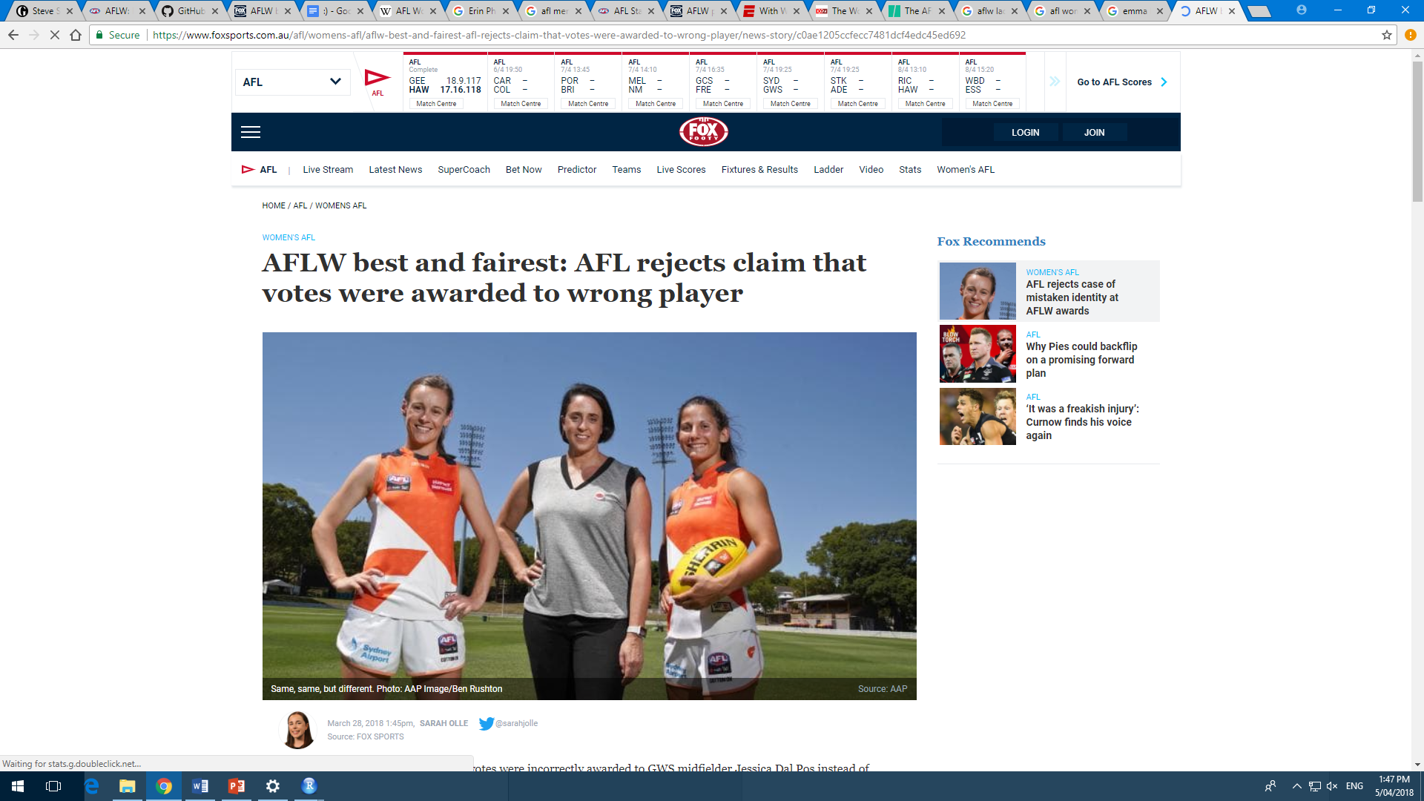
Nadine, Stella, Pamod, Sophie
Best and Fairest: Not so fair?
The player with the best performance in a game or over a season for a given sporting club or competitions, dependent on not receiving a suspension for misconduct or breaching the rules during that season.
Jessica Dal Pos 4 Votes
Alicia Eva 3 Votes
Erin Phillips 2017 Best and Fairest
Emma Kearney 2018 Best and Fairest
Fox Sport, March 2018
“What’s more, the AFL said it was not unusual for umpires and media outlets to have differing opinions when it came to players’ performances.
While media and coaches have access to statistics, umpires do not.”
“The Herald Sun, The Age and AFL media also named and voted Eva as best on ground. Dal Pos didn’t figure in any publication, nor the coaches’ votes.”

